Slide 1
Rate My Meal
Catriona Murphy 2312695
James Moore 2324008
Christopher Kelly 2313175
Ryan Williamson 2306841

Slide 2
Overview
The objective of our application is to connect food lovers by providing a platform for users to share their own food and rate others’ creations.
This application can be used for meal inspiration and for recipe ideas.
Chefs will be able to create an account and upload pictures and recipes. Food lovers can create an account and rate chef’s meals if they’ve tried them. If posting a picture of a meal eaten out there is an option to add the recipe.
There will be two types of users – verified chefs or home cooks. Verified chefs can create accounts and have their food promoted above others’.
Site admins will also exist with the ability to remove anyone’s posts.
On the home page, the newest chefs will be displayed.

Slide 3
Specifications
Every user must be able to create and edit their account, with the ability to deactivate their account
Every user must be able to log in and out of their account
Every user must be able to view and like recipes
Every user must be able to select a food category
Different users must have different access rights, i.e chefs must have a higher access right than normal users.
Chefs can upload recipes which can then be liked and viewed by anyone.
Anyone must be able to see the meals, but only registered users can interact with them.

Slide 4
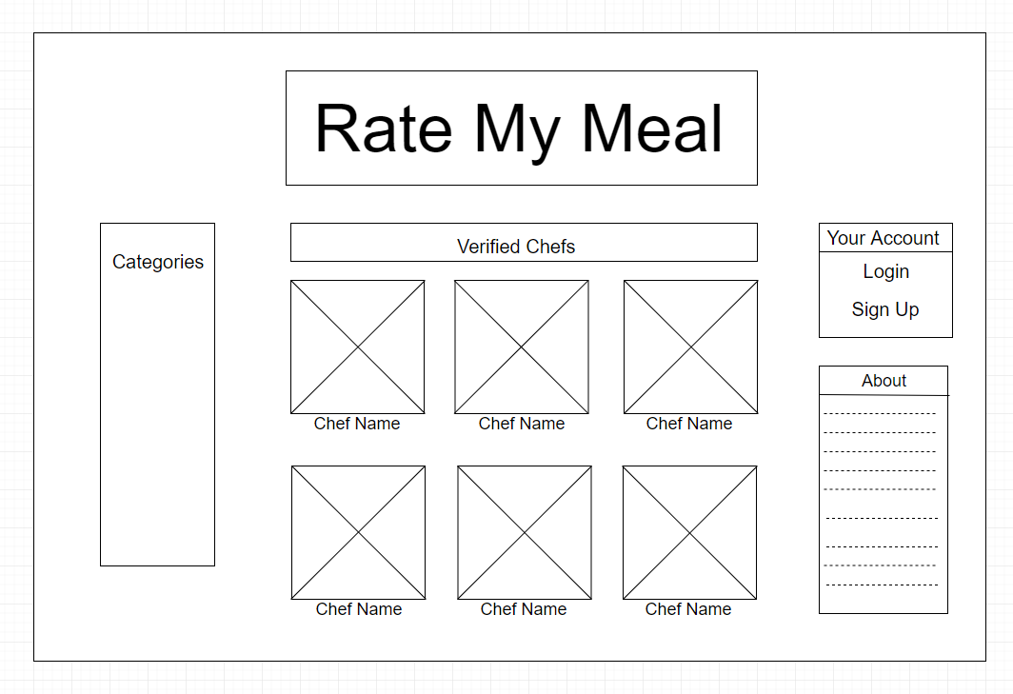
Wireframe – Index Page

Slide 5
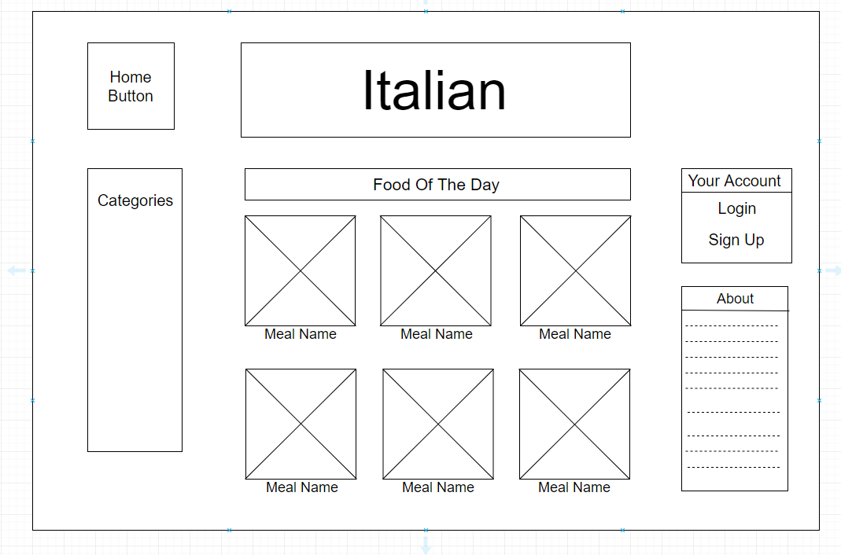
Wireframe – Italian (Category Page)

Slide 6
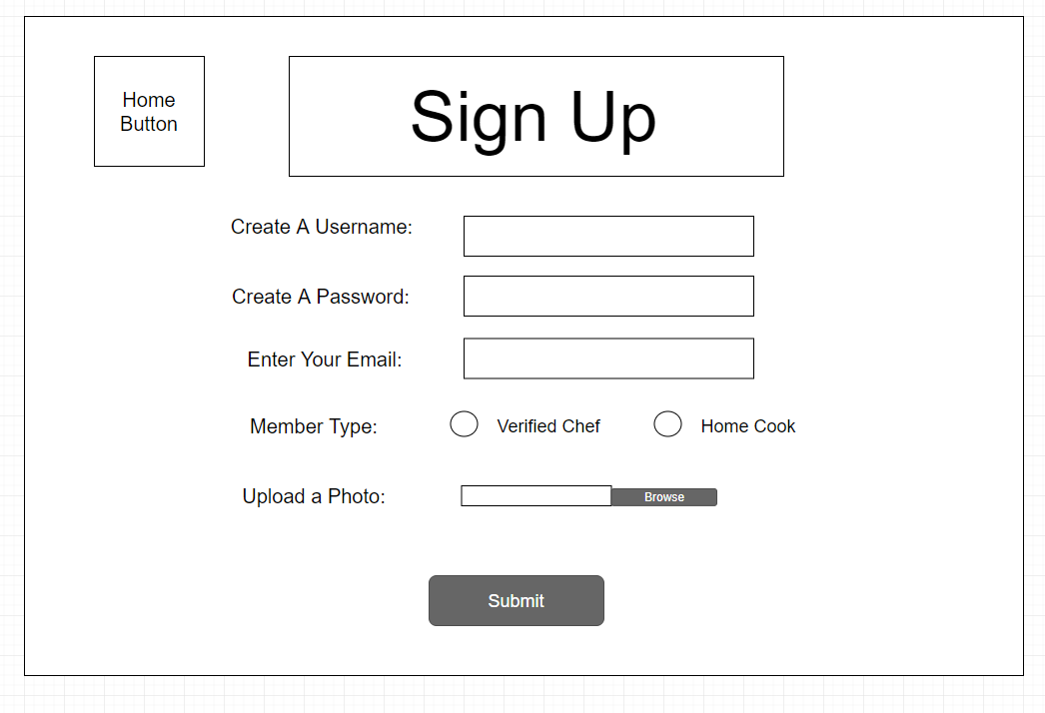
Wireframe – Sign-up

Slide 7
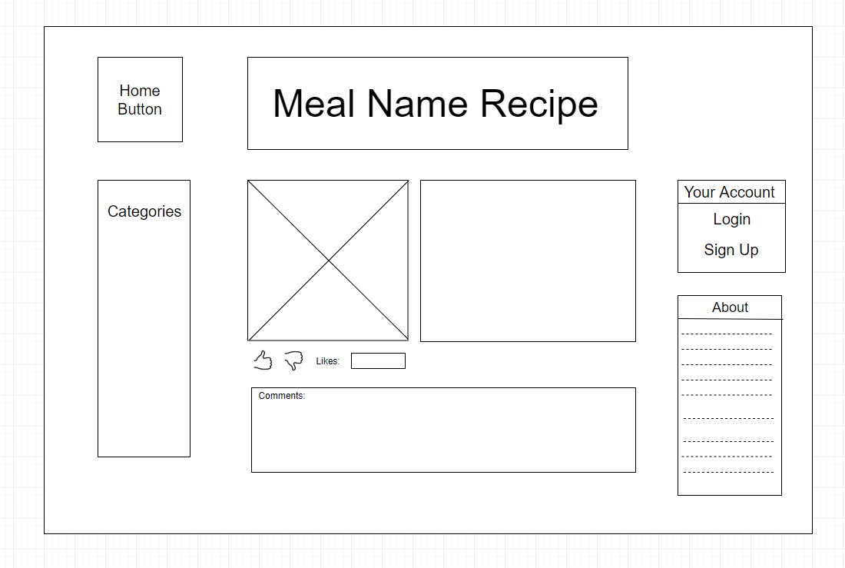
Wireframe - Recipe

Slide 8
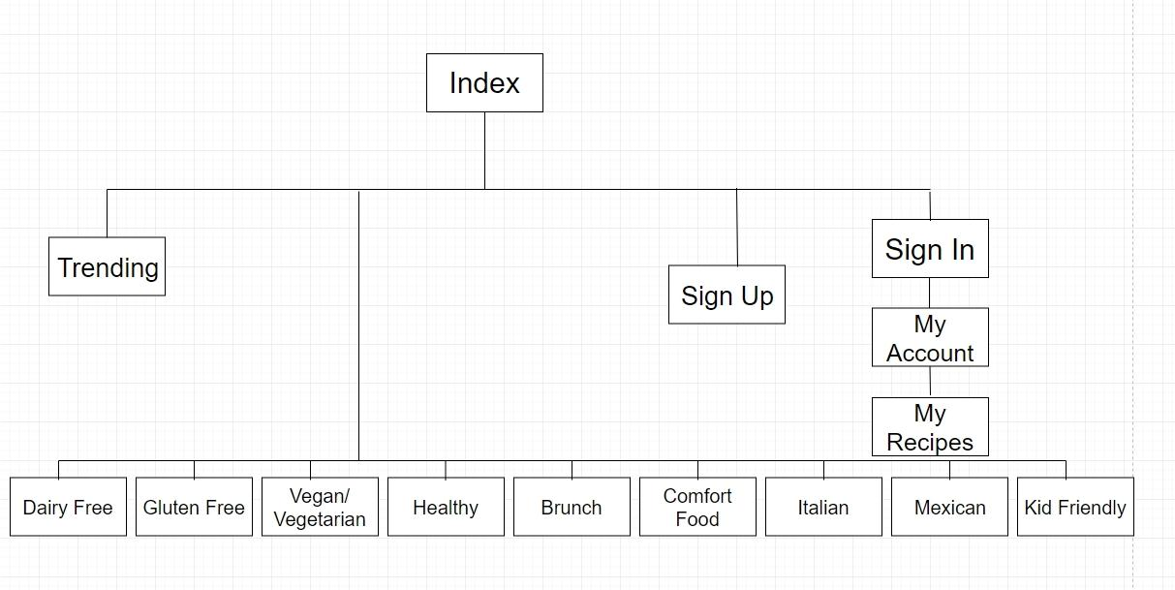
Site Map

Slide 9
Technologies Used
Python with Django –
Bootstrap –
Json –
AJAX –
Javascript –
HTML/CSS –

Slide 10
Our Contributions
Catriona – Over the course of the project I worked mainly on the template pages. My main priority was to ensure that all the pages were uniform, looked professional and suited the theme of our idea. I also incorporated bootstrap and javascript to make the webpages more dynamic.
Chris –
Jamie –
Ryan –

